Slide 1

Deadlock Detection
& Resource Allocation
Simulator
BY:
G.LAKSHMI DHARA HASINI-2420030421 G.LAKSHMI KEERTANA-2420090075
B.YASHWANTH-2420030707
LAXMAN-2420090064
N.AKHIL SAI-2420030315
Operating Systems | Deadlocks & Resource Management
BY:
G.LAKSHMI DHARA HASINI-2420030421 G.LAKSHMI KEERTANA-2420090075
B.YASHWANTH-2420030707
LAXMAN-2420090064
N.AKHIL SAI-2420030315
Academic Project Presentation | Department of Computer Science

Slide 2
Table of Contents
01
Abstract & Problem Statement
09
Simulator Features & Demo
02
OS Concepts: Deadlock Conditions
10
Detection & Recovery Strategies
03
Resource Allocation Graphs
11
Sample Output & Test Cases
04
Banker's Algorithm – Theory
12
Performance & Complexity Analysis
05
Wait-For Graph – Theory
13
Expected Outcomes
06
System Architecture & Design
14
Learning Outcomes
07
Core Implementation – Part 1
15
Conclusion & References
08
Core Implementation – Part 2

Slide 3
Abstract & Problem Statement
ABSTRACT
PROBLEM
This project develops an interactive simulator that models OS-level process scheduling and resource management. It implements Banker's Algorithm for deadlock avoidance and Wait-For Graph analysis for detection. The system visualizes resource allocation states in real-time, enabling students to observe deadlock formation, prevention, and recovery in a controlled environment. It bridges the gap between theoretical OS concepts and practical hands-on understanding.
Deadlocks are a critical OS challenge where processes indefinitely wait for resources held by each other. Existing tools lack interactive, visual simulation capabilities. Goal: Build a real-time simulator that models, detects, and resolves deadlocks using proven algorithms.
Mutual Exclusion
Hold & Wait
Circular Wait
Resources cannot be shared — held exclusively
Process holds resources while waiting for more
Chain of processes waiting for each other

Slide 4
OS Concepts: The Four Deadlock Conditions
Coffman (1971) — ALL four must hold simultaneously for deadlock to occur
1
Mutual Exclusion
3
No Preemption
At least one resource must be held in a non-sharable mode. Only one process can use the resource at a time. Others must wait until the resource is released.
Resources cannot be preempted. A resource can only be voluntarily released by the process holding it after it has completed its task.
2
Hold and Wait
4
Circular Wait
A process holding at least one resource is waiting to acquire additional resources that are currently being held by other processes.
A set {P0, P1, …, Pn} of waiting processes exists such that P0 waits for P1, P1 waits for P2, …, Pn−1 waits for Pn, and Pn waits for P0.

Slide 5
Resource Allocation Graphs (RAG)
Nodes:
Resource Allocation Graph — Example
Processes shown as circles (P1, P2…) | Resources shown as rectangles (R1, R2…)
P1
R1
P3
Request Edge:
Arrow from Process → Resource means the process is requesting the resource
Assignment Edge:
P2
R2
P4
Arrow from Resource → Process means the resource is assigned to the process
Cycle Detection:
A cycle in the RAG is a necessary condition for deadlock. With single instances, it is also sufficient.
Process
Resource
→ Assignment / Request

Slide 6
Banker's Algorithm — Theory & Logic
Key Data Structures
Safety Algorithm Steps
Available[ m ]
1
Initialize
Vector of available instances of each resource type
Work = Available; Finish[i] = false for all i
2
Find i such that:
Max[ n×m ]
Maximum demand of each process for each resource type
Finish[i]=false AND Need[i] ≤ Work
3
Simulate release
Allocation[ n×m ]
Work = Work + Allocation[i]; Finish[i] = true
Number of resources currently allocated to each process
4
Repeat Step 2
Need[ n×m ]
Until no such i exists in the process set
Remaining resource need = Max − Allocation
5
Check safety
If Finish[i]=true for all i → SAFE STATE

Slide 7
Wait-For Graph (WFG) — Theory & Cycle Detection
What is a Wait-For Graph?
DFS Cycle Detection — Pseudocode
Derived from RAG
function detectCycle(graph):
Created by removing resource nodes — only processes remain as nodes
visited = {}
recStack = {}
Edge Pi → Pj
for each node in graph:
Means Pi is waiting for a resource held by Pj
if DFS(node, visited, recStack):
return DEADLOCK_DETECTED
return NO_DEADLOCK
Deadlock Condition
function DFS(v, visited, recStack):
A cycle in the WFG indicates a DEADLOCK among the involved processes
visited[v] = true
recStack[v] = true
Detection Frequency
for neighbor in graph[v]:
if not visited[neighbor]:
WFG is analyzed periodically or on each allocation/release event
if DFS(neighbor, …):
return true
elif recStack[neighbor]:
Cycle Detection
return true # cycle!
DFS (Depth-First Search) traversal used to detect back edges (cycles)
recStack[v] = false
return false

Slide 8
System Architecture & Design
UI / Visualization Layer
Interactive process/resource controls, real-time RAG rendering, safe sequence display
Simulation Engine
Process scheduler, resource request/release handler, state machine manager
Algorithm Module
Banker's Algorithm (avoidance), DFS-based WFG cycle detection (deadlock detection)
Data Store
Allocation matrices, Available vectors, Need tables, process state tracking
Technology Stack
Python 3.x
Tkinter / PyQt
NetworkX (graphs)
Matplotlib
NumPy (matrices)
Threading

Slide 9
Core Implementation — Banker's Algorithm
import numpy as np
class BankersAlgorithm:
def __init__(self, processes, resources, allocation, max_demand, available):
self.n = processes # number of processes
self.m = resources # number of resource types
self.allocation = np.array(allocation)
self.max_need = np.array(max_demand)
self.available = np.array(available)
self.need = self.max_need - self.allocation
def is_safe(self):
work = self.available.copy()
finish = [False] * self.n
safe_seq = []
while len(safe_seq) < self.n:
progress = False
for i in range(self.n):
if not finish[i] and all(self.need[i] <= work):
work += self.allocation[i]
finish[i] = True
safe_seq.append(i); progress = True
if not progress: return None # DEADLOCK
return safe_seq # Safe sequence found

Slide 10
Core Implementation — WFG & Resource Manager
Wait-For Graph + Cycle Detection
Resource Request Handler
import networkx as nx
def request_resources(self,pid,req):
# Step 1: Validate request
class WaitForGraph:
if any(req > self.need[pid]):
def __init__(self, n_proc):
raise Exception('Exceeds max')
self.graph = nx.DiGraph()
if any(req > self.available):
self.graph.add_nodes_from(
return 'WAIT' # must wait
range(n_proc))
# Step 2: Pretend-allocate
def add_wait(self, pi, pj):
self.available -= req
# Pi waits for Pj
self.allocation[pid] += req
self.graph.add_edge(pi, pj)
self.need[pid] -= req
def remove_wait(self, pi, pj):
# Step 3: Safety check
if self.graph.has_edge(pi,pj):
safe = self.is_safe()
self.graph.remove_edge(pi,pj)
if safe is not None:
return f'GRANTED {safe}'
def detect_deadlock(self):
else:
try:
# Rollback allocation
cycle = nx.find_cycle(
self.available += req
self.graph, orientation='original')
self.allocation[pid] -= req
return True, cycle
self.need[pid] += req
except nx.NetworkXNoCycle:
return 'DENIED (unsafe)'
return False, []

Slide 11






Simulator Features & Capabilities
Multi-Process Simulation
Real-Time RAG Visualization
Configure 2–10 processes and up to 5 resource types. Set Max demand matrix interactively.
Live graph updates on every request/release. Color-coded edges: green=assigned, red=waiting.
Deadlock Detection Engine
Safe Sequence Finder
Automatic WFG cycle detection after each state change. Highlights deadlocked processes in red.
Banker's safety check returns safe execution order e.g., <P1, P3, P0, P2, P4>.
Recovery Strategies
Step-by-Step Mode
Three modes: Process Termination, Resource Preemption, Rollback. User selects strategy.
Pause at each state, inspect matrices (Allocation, Need, Available) after every action.

Slide 12
Deadlock Detection & Recovery Strategies
Detection Approach
Process Termination
Periodic Detection:
Run WFG cycle detection every T time units.
On-Event Detection:
Trigger check on each resource request or process block.
Resource-Instance Based:
For multi-instance: use Banker's detection variant.
Abort all deadlocked processes (costly)
Abort one at a time (re-run detection)
Choose victim by priority, runtime, resources held
Resource Preemption
Select a victim process to preempt from
Detection vs. Avoidance
Rollback victim to safe state (checkpoint)
Aspect | Avoidance | Detection
Overhead | High (per-request) | Medium (periodic)
Knowledge | Max demand known | No prior info
Safety | Deadlock-free | May hit deadlock
Algorithm | Banker's | WFG / DFS
Prevent starvation by tracking preemption count
Rollback & Restart
Checkpoint system state periodically
Rollback deadlocked processes to checkpoint
Restart from last safe known state

Slide 13
Sample Output & Test Cases
Banker's Algorithm — Example State
Test Scenarios
Process | Allocation (A B C) | Max (A B C) | Need (A B C)
P0 | 0 1 0 | 7 5 3 | 7 4 3
P1 | 2 0 0 | 3 2 2 | 1 2 2
P2 | 3 0 2 | 9 0 2 | 6 0 0
P3 | 2 1 1 | 2 2 2 | 0 1 1
P4 | 0 0 2 | 4 3 3 | 4 3 1
PASS
TC-01: Safe state with valid sequence
PASS
TC-02: Safe request granted correctly
DENY
TC-03: Unsafe request denied (rollback)
DEAD
TC-04: Deadlock detected via WFG cycle
RECV
TC-05: Recovery via process termination
Available: A=3, B=3, C=2
✓ Safe Sequence: P1 → P3 → P4 → P0 → P2
PASS
TC-06: All resources released — clean state
Simulator Console Output:
[INFO] Process P1 requests [1,0,2]... checking safety... GRANTED | Safe seq: P1→P3→P4→P0→P2
[ALERT] Deadlock detected! Cycle: P2 → P3 → P2 | Recovery: Terminating P3 (lowest priority)

Slide 14
Performance & Complexity Analysis
Banker's Safety Check
Resource Request Check
Time:
O(n² × m)
Time:
O(n² × m)
Space:
O(n × m)
Space:
O(n × m)
n = processes, m = resource types. Inner loop per process pass.
Includes safety algorithm after tentative allocation.
WFG Cycle Detection
RAG Visualization
Time:
O(V + E)
Time:
O(V + E)
Space:
O(V)
Space:
O(V + E)
DFS traversal. V = processes, E = wait edges. Very efficient.
Graph rendering based on NetworkX/Matplotlib layout algorithms.
Benchmarks (5 processes, 3 resource types, 1000 iterations)
< 2 ms
< 0.5 ms
~12 MB
30 FPS
Avg Safety Check
WFG Cycle Detect
Memory Usage
UI Refresh Rate

Slide 15
Expected Outcomes, Learning Goals & Conclusion
Expected Outcomes
Learning Outcomes
Functional simulator with Banker's Algorithm and WFG detection
Deep understanding of all four necessary deadlock conditions
Real-time RAG visualization with interactive controls
Ability to construct and analyze Resource Allocation Graphs
Detection of deadlocks within milliseconds of occurrence
Hands-on mastery of Banker's Algorithm for safe-state checks
Automated safe-sequence output and recovery suggestions
Understanding WFG-based deadlock detection via DFS cycles
Comprehensive test suite covering all four deadlock conditions
Experience with OS-level recovery strategies and trade-offs
Conclusion
This Deadlock Detection & Resource Allocation Simulator provides a holistic, hands-on learning environment for Operating Systems concepts. By combining Banker's Algorithm for avoidance with Wait-For Graph analysis for detection, students gain comprehensive insight into how modern OS kernels prevent and recover from deadlocks. The tool's real-time visualization and step-by-step mode transform abstract theoretical concepts into observable, interactive experiences — bridging the gap between OS theory and systems programming practice.
References:
Silberschatz, Galvin & Gagne — Operating System Concepts (10th Ed.) | Tanenbaum — Modern Operating Systems (4th Ed.) | Coffman et al. (1971) — System Deadlocks
networkx.org | matplotlib.org | numpy.org | Python Docs — threading module

Slide 16
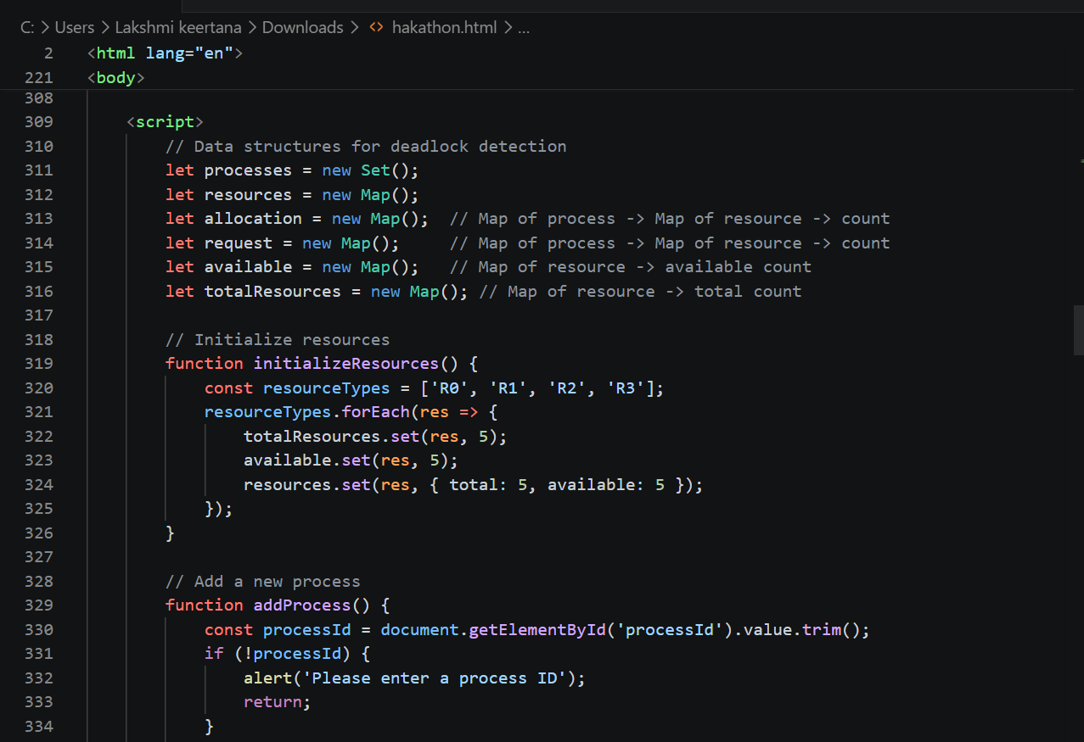
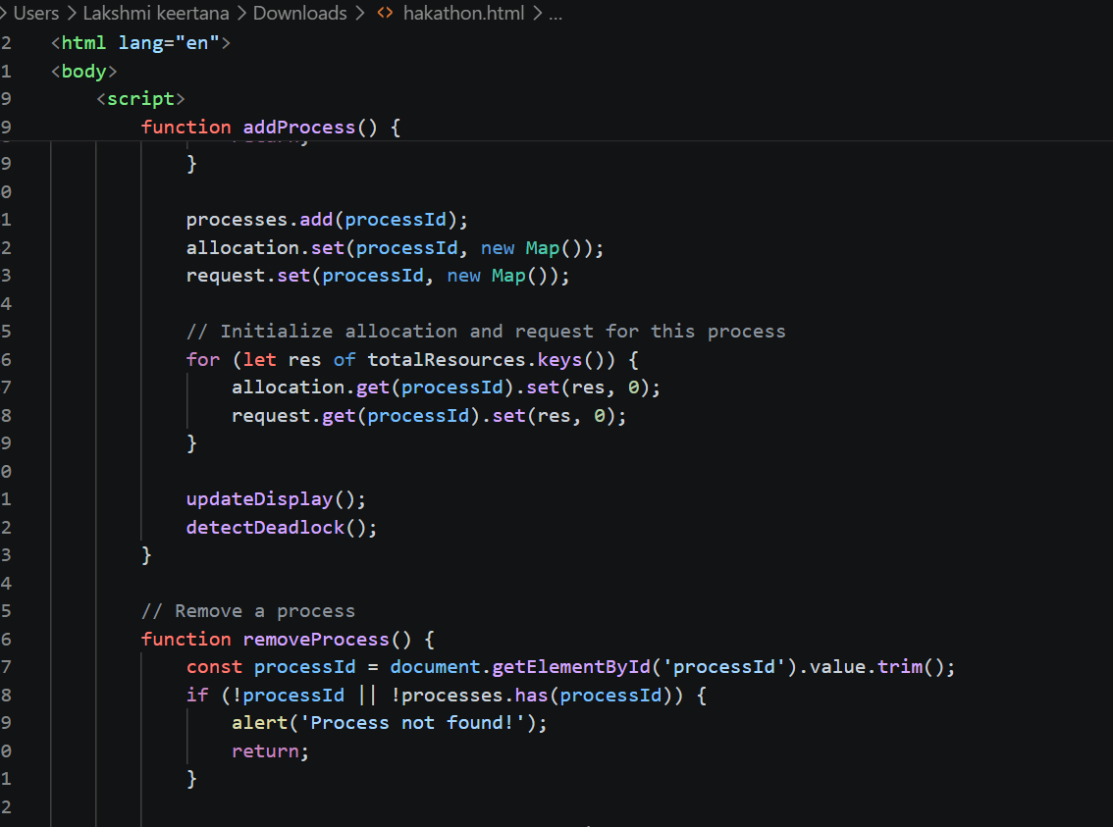
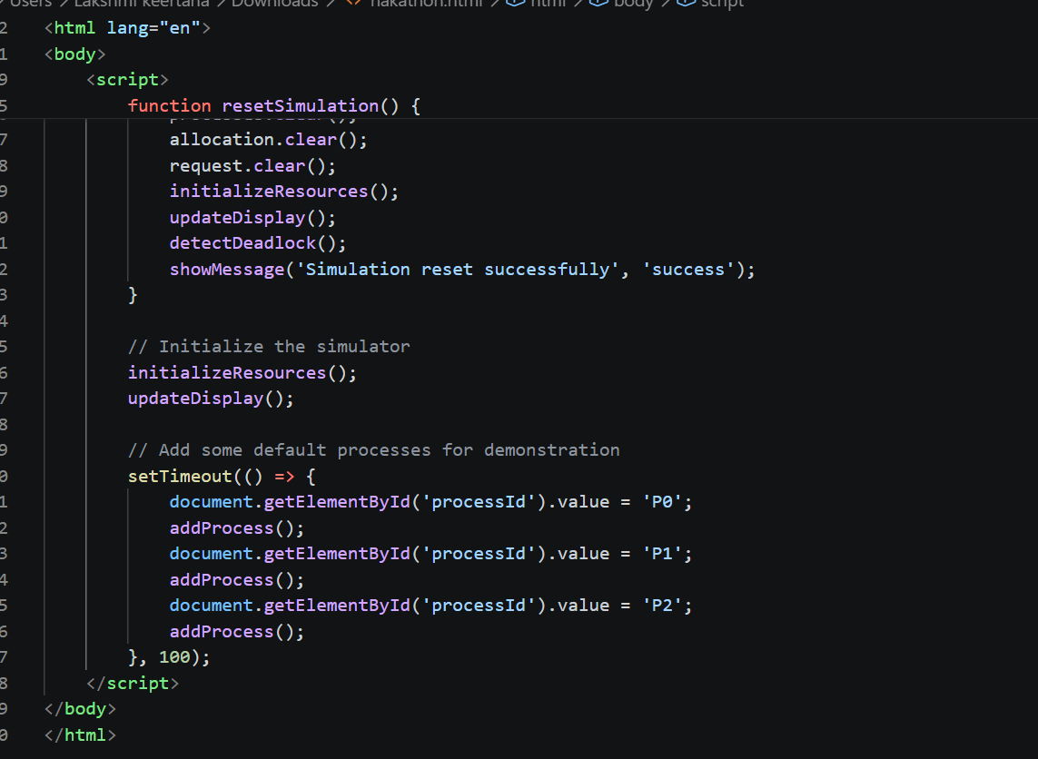

Slide 17
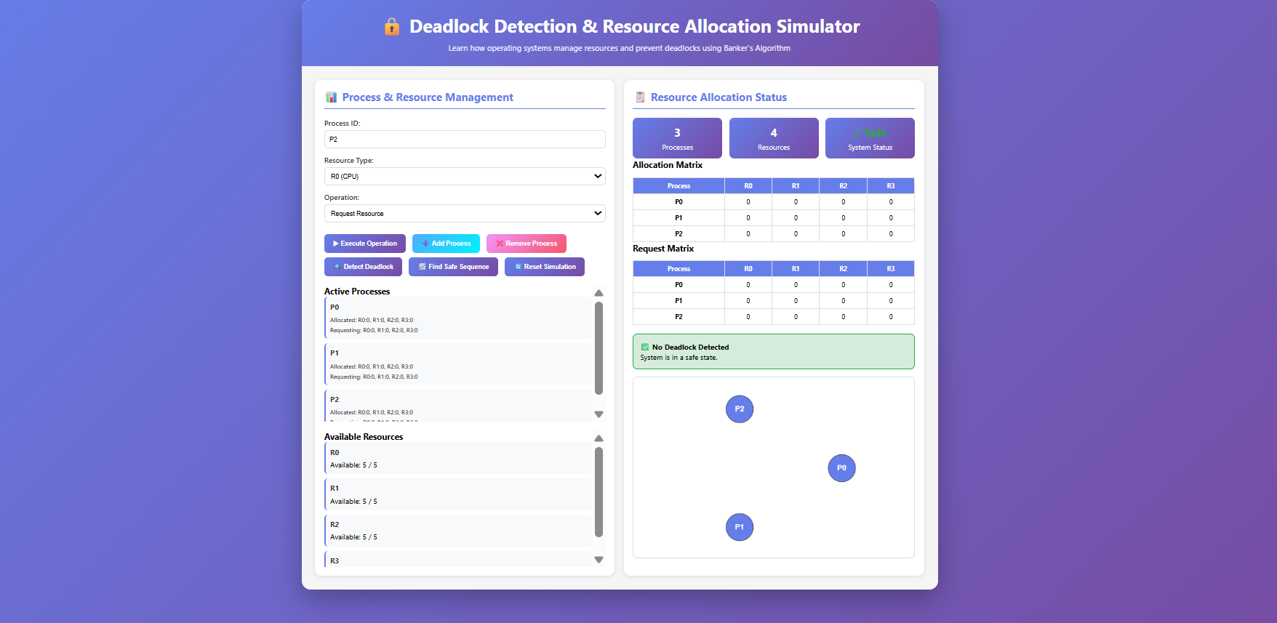

Slide 18
THANK YOU

